Slide 1



Slide 2
FHIR Deep Dive: LAB

Slide 3
Setup

Slide 4
Installation
Download PDF: https://goo.gl/K4oofl
Install Postman: https://www.getpostman.com/
This is a ReST client that will help make service calls
The FHIR server we will be working with today is: https://fhir-open.sandboxcerner.com/dstu2/0b8a0111-e8e6-4c26-a91c-5069cbc6b1ca/
Notes:
Note: Make sure to remove spaces in your URL for FHIR - there should be none.

Slide 5
Patients
Smart, Valerie (id: 4596007)
Smart, Wilma (id: 4342008)
Smart, Nancy (id: 4342009)
Smart, Joe (id: 4342010)
Smart, Hailey (id: 4342011)
Smart, Timmy (id: 4342012)
Smart, Fred (id: 4478007)
Peters, Tim (id: 1316024)

Slide 6
Exercise 1

Slide 7
Exercise 1
Identify the FMM (maturity model) of the Following resources for DSTU 2:
Patient
Condition
Observation
Coverage

Slide 8
Exercise 1: Answer
Identify the FMM (maturity model) of the Following resources for DSTU 2: http://hl7.org/fhir/dstu2/resourcelist.html
Patient: 3
Condition: 2
Observation: 3
Coverage: 0

Slide 9
Exercise 2

Slide 10
Exercise 2
Find out what resources are available in Millennium’s HL7 FHIR DSTU 2 implementation that are not in the May2015 implementation.

Slide 11
Exercise 2: Answer
RelatedPerson
Contract
Person
Device
Optional: MedicationOrder (MedicationPrescription was just renamed)

Slide 12
Exercise 3

Slide 13
Exercise 3
What search parameters does the Millennium DSTU 2 implementation of Patient support? Are there any limitations or considerations?

Slide 14
Exercise 3: Answer
Query by: id
Query by: identifier
Query by a combination of: birthdate, name, telecom
_count (paging)
birthdate, name, and telecom has limited availability, and “fuzzy”
http://fhir.cerner.com/dstu2/patient/#parameters

Slide 15
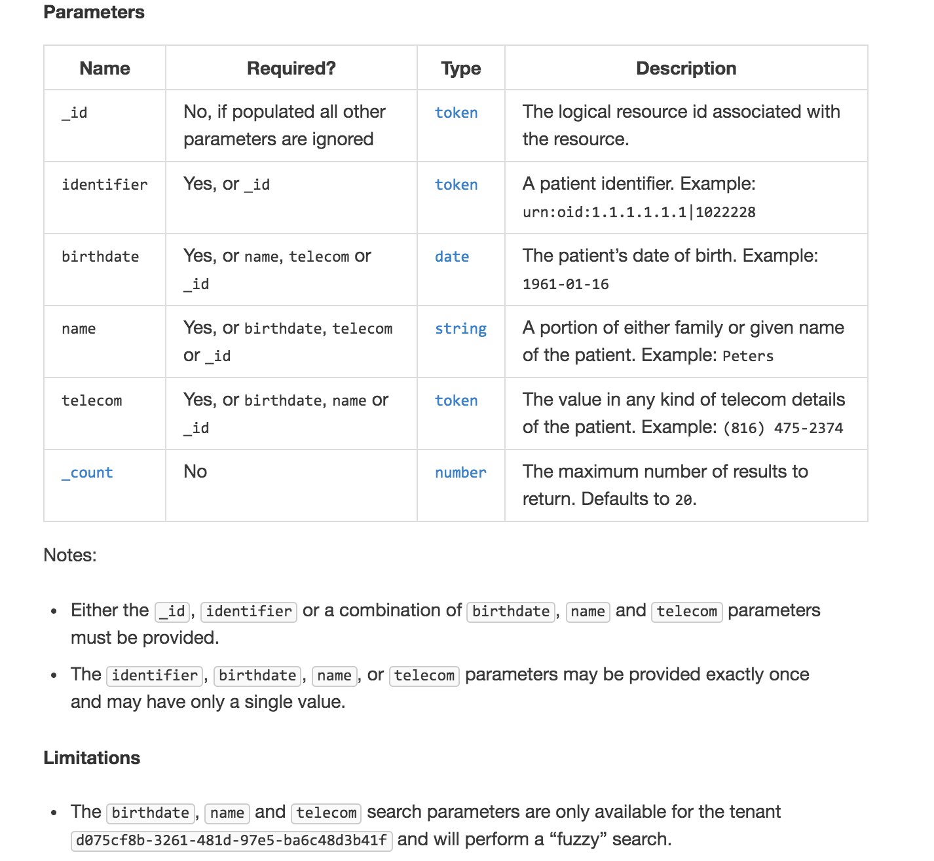

Slide 16
Exercise 4

Slide 17
Exercise 4
According to the Conformance statement, does this FHIR server support OAuth? https://fhir-open.sandboxcerner.com/dstu2/0b8a0111-e8e6-4c26-a91c-5069cbc6b1ca/
Notes:
Note: Make sure to remove spaces in your URL for FHIR - there should be none, and having spaces in the server URL will cause errors. HTTP URLs are space and case sensitive.

Slide 18
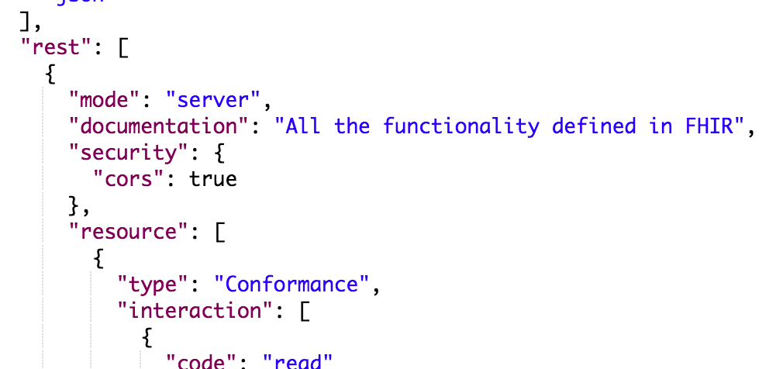

Exercise 4: Answer
Answer: No (it’s our open endpoint)
GET https://fhir-open.sandboxcerner.com/dstu2/0b8a0111-e8e6-4c26-a91c-5069cbc6b1ca/metadata?_format=json

Slide 19
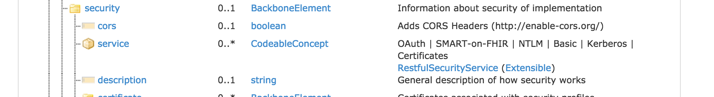

http://hl7.org/fhir/dstu2/conformance.html

Slide 20
Exercise 5

Slide 21
Exercise 5
Find out the middle name for Fred Smart (id 4478007)

Slide 22
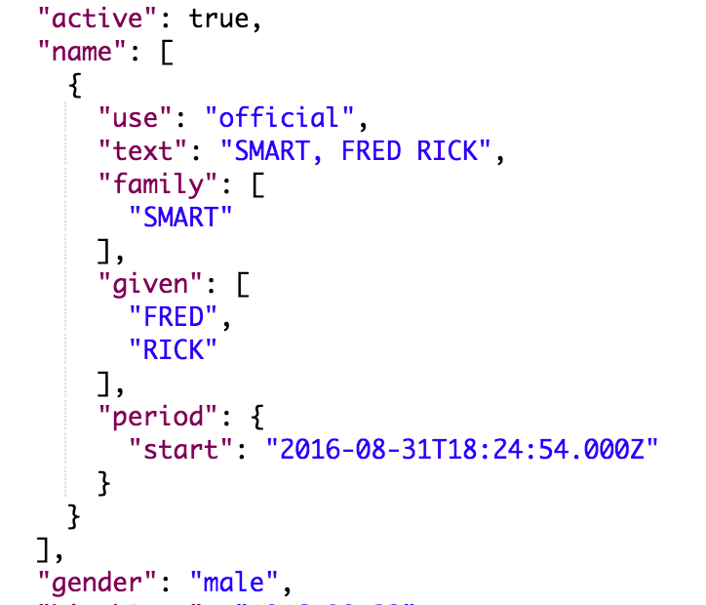
Exercise 5: Answer
Answer: Rick
GET https://fhir-open.sandboxcerner.com/dstu2/0b8a0111-e8e6-4c26-a91c-5069cbc6b1ca/Patient/4478007?_format=json
http://hl7.org/fhir/dstu2/datatypes.html#HumanName (middle is subsequent given name)
Notes:
Note: Patient vs Person. Person represents people “in the real world” for example, it could link to your patient record in many FHIR servers. In CommonWell, most of the core is the “Person” and the records they’re tied to are Patient. We would use Patient here since we’re looking at patient records in an EHR.

Slide 23
Exercise 6

Slide 24
Exercise 6
How many current allergies or intolerances does Tim Peters have?
Current: actual or possible existing allergies or intolerances
Hint: What indicates “current” for this FHIR resource?

Slide 25
Exercise 6: Answer
20
GET https://fhir-open.sandboxcerner.com/dstu2/0b8a0111-e8e6-4c26-a91c-5069cbc6b1ca/AllergyIntolerance?patient=1316024&_format=json
GET https://fhir-open.sandboxcerner.com/dstu2/0b8a0111-e8e6-4c26-a91c-5069cbc6b1ca/AllergyIntolerance?patient=1316024&status=active,unconfirmed,confirmed&_format=json
Notes:
Note: AllergyIntolerance/123 is looking up an Allergy by its id (not a patient id). Similarly, AllergyIntolerance?_id=123 is looking up allergy by id, not by the patient id.

Slide 26
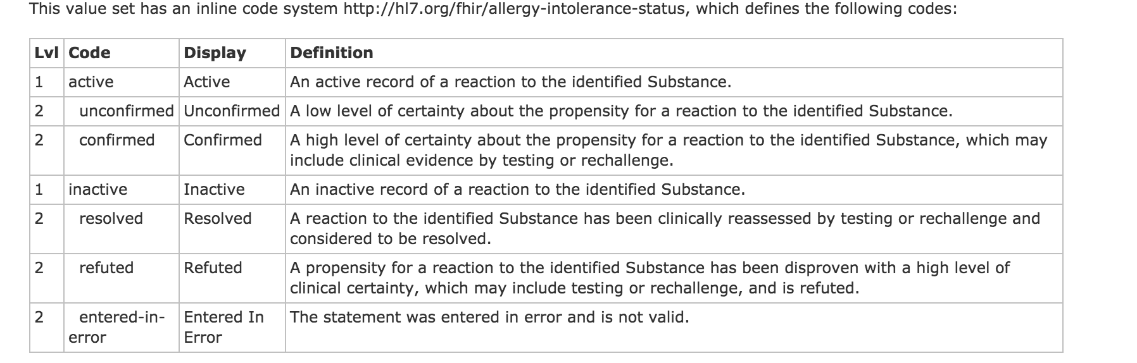
http://hl7.org/fhir/DSTU2/valueset-allergy-intolerance-status.html

Slide 27

What if it wasn’t mapped/known?
http://hl7.org/fhir/dstu2/allergyintolerance.html

Slide 28
Exercise 7

Slide 29
Exercise 7
Does Wilma Smart have a normal blood pressure?
Hint: LOINC 55284-4 can be used to find blood pressures

Slide 30
Exercise 7: Answer
No - it’s High
GET https://fhir-open.sandboxcerner.com/dstu2/0b8a0111-e8e6-4c26-a91c-5069cbc6b1ca/Observation?subject%3APatient=4342008&code=http%3A%2F%2Floinc.org%7C55284-4 (code: http://loinc.org|55284-4)
Notes:
You need to ensure you properly escape/encode the URL so that protected characters are percent encoded. This is to ensure that the server can interpret the URL correctly. Postman does this for you, and *some* http libraries will, but make sure your code (or app) handles this logic to encode or decode as needed.

Slide 31
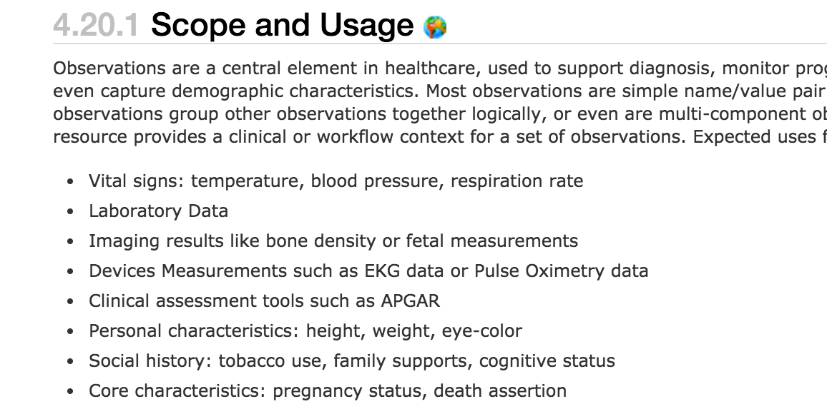
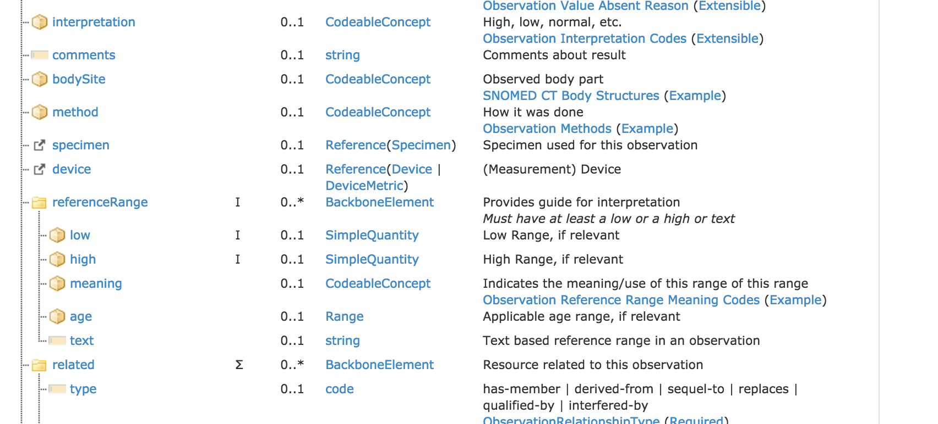
http://hl7.org/fhir/dstu2/observation.html

Slide 32
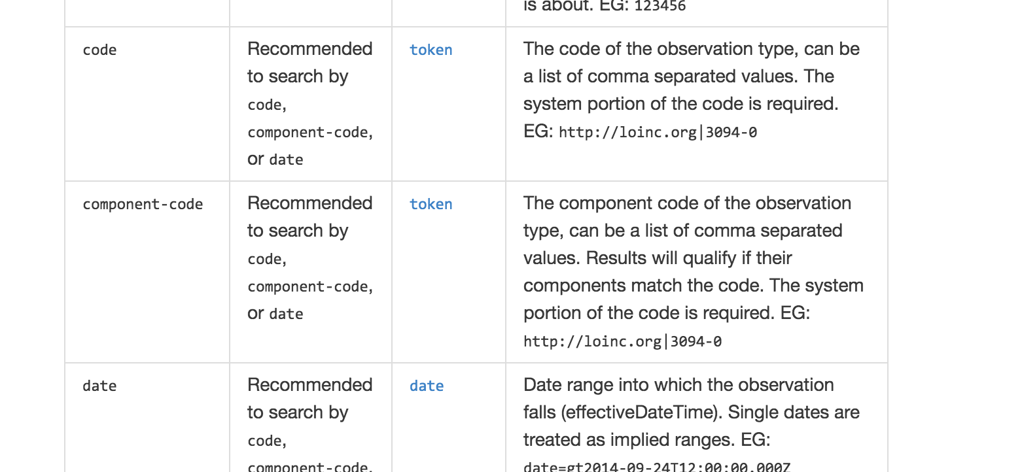
http://fhir.cerner.com/dstu2/observation/

Slide 33
Exercise 8

Slide 34
Exercise 8
What is the name of the patient with MRN 10000363
Hint: the system is urn:oid:1.1.1.1.1.1 (oid)

Slide 35
Exercise 8: Answer
Amy Hilton
GET https://fhir-open.sandboxcerner.com/dstu2/0b8a0111-e8e6-4c26-a91c-5069cbc6b1ca/Patient?identifier=urn:oid:1.1.1.1.1.1|10000363&_format=json

Slide 36
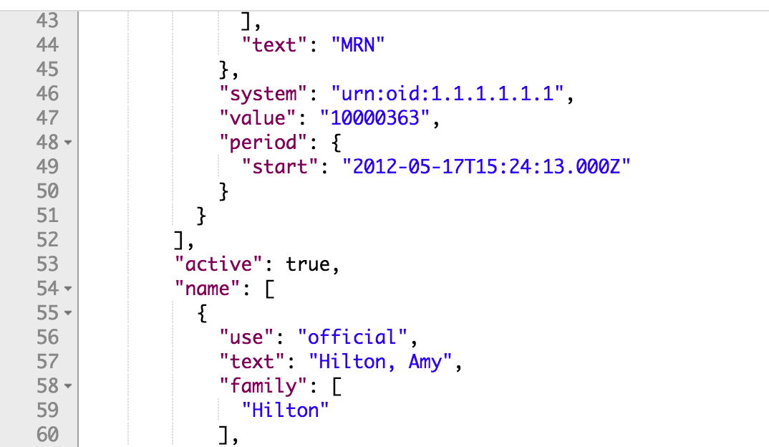

Slide 37
Exercise 9

Slide 38
Exercise 9
Is Fred Smart currently taking insulin?

Slide 39
Exercise 9: Answer
Answer: Yes
GET https://fhir-open.sandboxcerner.com/dstu2/0b8a0111-e8e6-4c26-a91c-5069cbc6b1ca/MedicationStatement?patient=4478007&_format=json
GET https://fhir-open.sandboxcerner.com/dstu2/0b8a0111-e8e6-4c26-a91c-5069cbc6b1ca/MedicationOrder?patient=4478007&_format=json
Difference?

Slide 40
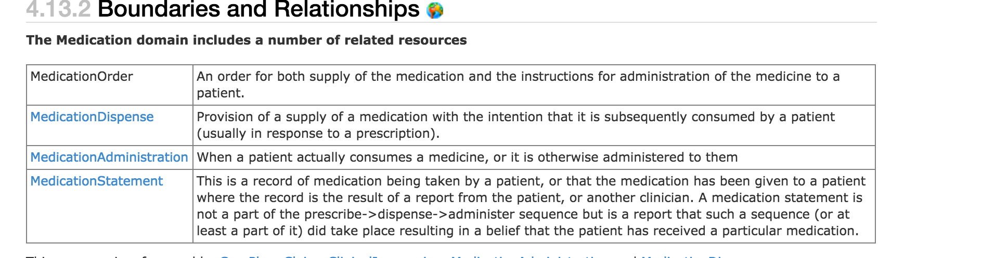
http://hl7.org/fhir/dstu2/medicationorder.html#bnr

Slide 41
Exercise 10

Slide 42
Exercise 10
Which has a pacemaker: Fred Smart or Tim Peters?

Slide 43
Exercise 10: Answer
Fred
GET https://fhir-open.sandboxcerner.com/dstu2/0b8a0111-e8e6-4c26-a91c-5069cbc6b1ca/Device?patient=4478007&_format=json
and possibly Google (Medtronic Advisa MRI SureScan)
GET https://fhir-open.sandboxcerner.com/dstu2/0b8a0111-e8e6-4c26-a91c-5069cbc6b1ca/Device?patient=1316024&_format=json

Slide 44
Exercise 11

Slide 45
Exercise 11
How many different orders of Advil Cold and Sinus does Tim Peters have?

Slide 46
Exercise 11: Answer
1
GET https://fhir-open.sandboxcerner.com/dstu2/0b8a0111-e8e6-4c26-a91c-5069cbc6b1ca/MedicationOrder?patient=1316024&status=active,on-hold&_format=json

Slide 47
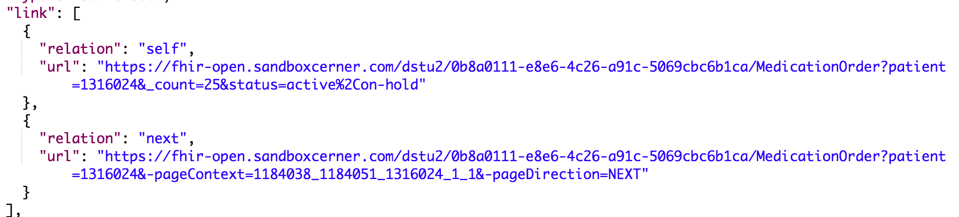
Paging
GET https://fhir-open.sandboxcerner.com/dstu2/0b8a0111-e8e6-4c26-a91c-5069cbc6b1ca/MedicationOrder?patient=1316024&-pageContext=1184038_1184051_1316024_1_1&-pageDirection=NEXT&_format=json
Added _format parameter

Slide 48
MedicationStatement?
Could have, though question said order.
Result would have been the same, but statuses would have been “active,intended”

Slide 49
Exercise 12

Slide 50
Exercise 12
Who is patient 2918007’s mother?

Slide 51
Exercise 12: Answer
Answer: CWDTEST, GUARDIAN
GET https://fhir-open.sandboxcerner.com/dstu2/0b8a0111-e8e6-4c26-a91c-5069cbc6b1ca/RelatedPerson?patient=2918007&_format=json

Slide 52
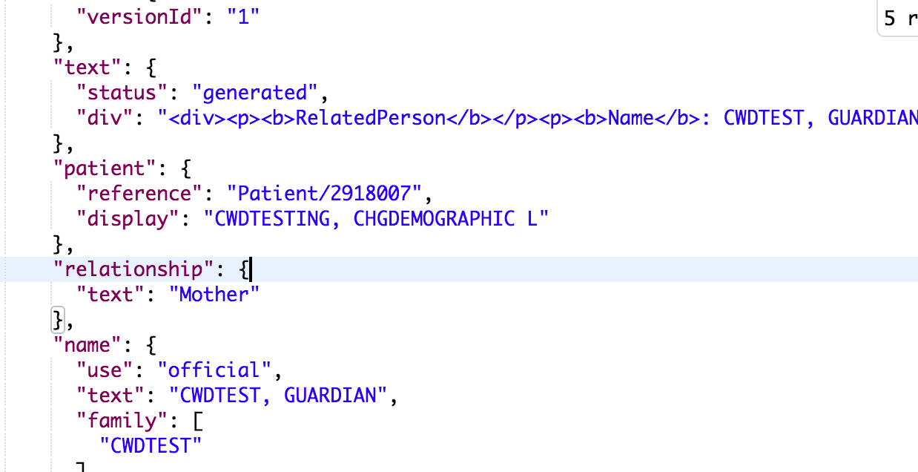

Slide 53
Exercise 13

Slide 54
Exercise 13
What happens when you query Condition for Joe Smart and filter by a category of complaint? Why?

Slide 55
Exercise 13: Answer
Answer: An error (422), because complaint isn’t supported
GET https://fhir-open.sandboxcerner.com/dstu2/0b8a0111-e8e6-4c26-a91c-5069cbc6b1ca/Condition?patient=4342010&category=complaint&_format=json
http://fhir.cerner.com/dstu2/condition/#terminology-bindings

Slide 56
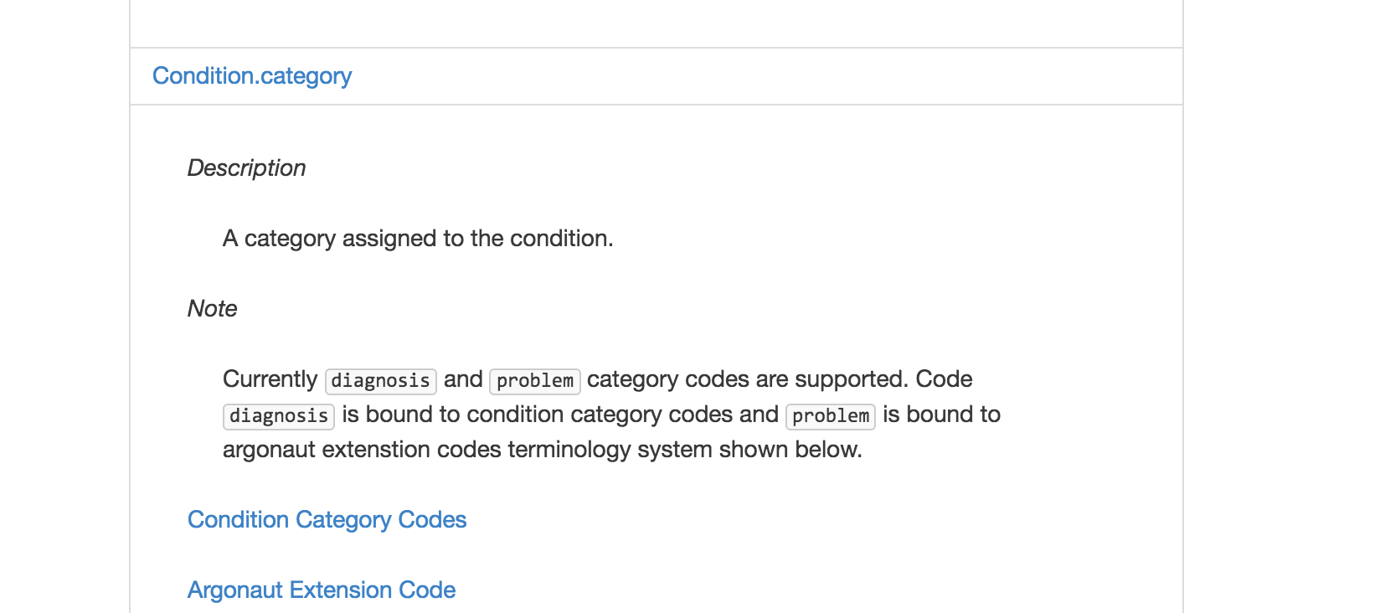

Slide 57
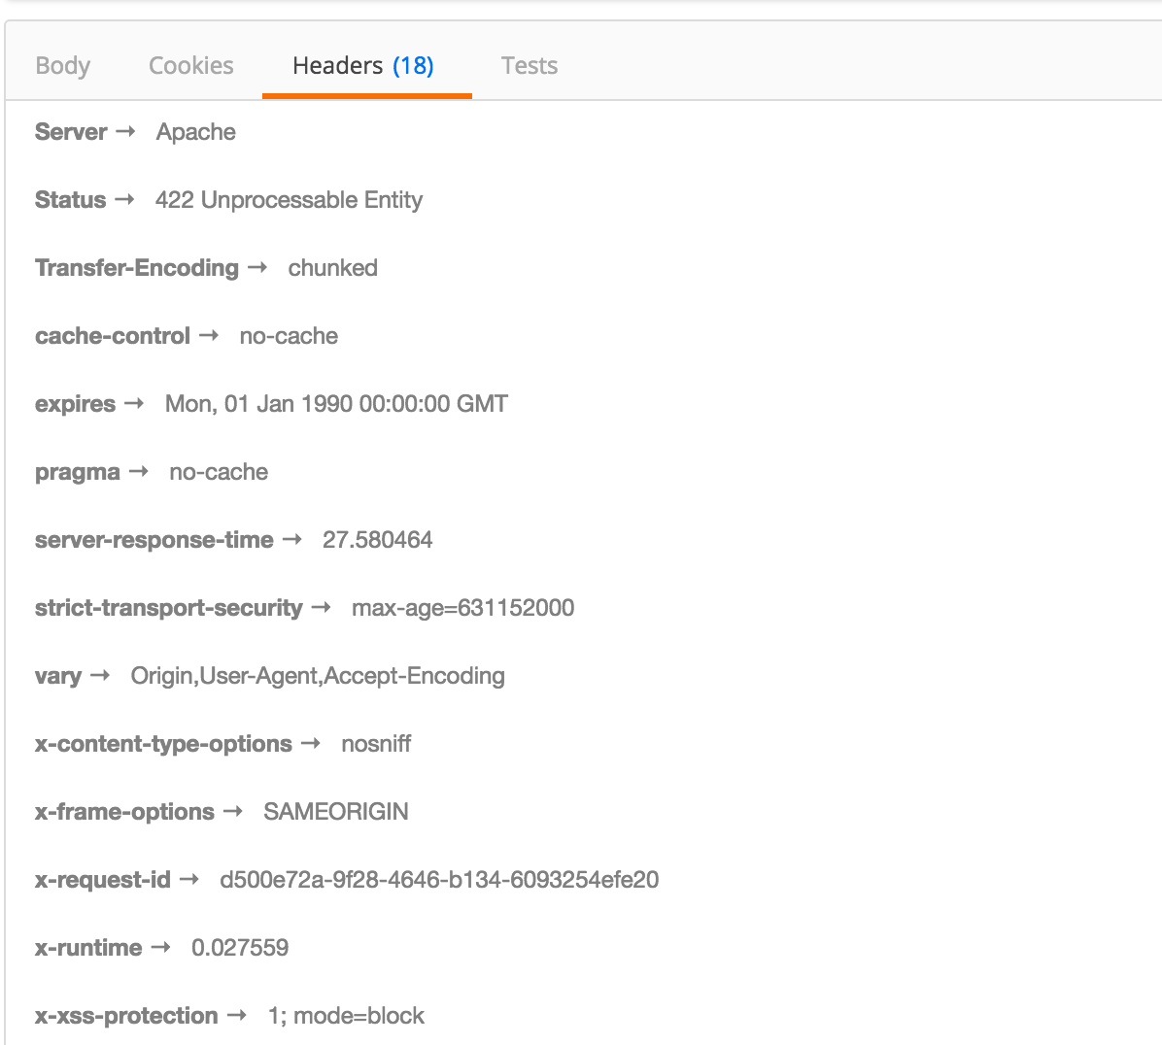
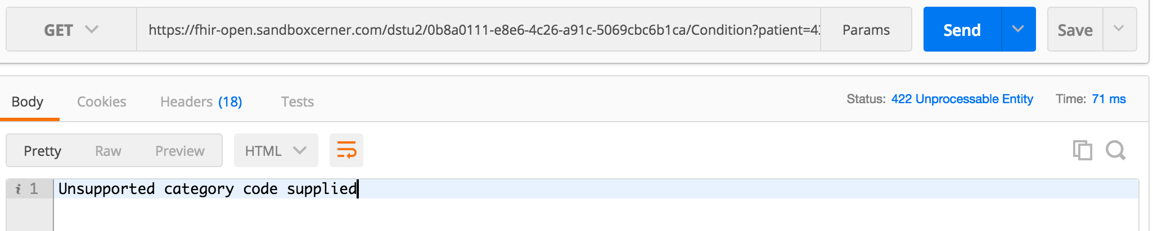


Slide 58
Bonus Round

Slide 59
Questions?

